Slide 1

The Impact of Social Determinants of Health on Hospital Readmission Rates for Select TN Hospitals
Matt Bach – Data Analytics Cohort 1

Slide 2
AGENDA
To explore the relationship between the Social Determinants of Health and Hospital Readmission Rates for 4 TN Hospitals. This will entail an exploratory analysis of several datasets to find correlations (positive and negative) between the determinants and the 6 conditions measured by the Hospital Readmission Reduction Program.
To further understand the complexities of these relationships by exploring relationships among the Social Determinants of Health themselves (e.g., how a person’s education level might impact the crime rate for a given hospital/region, etc.).
To make recommendations as to how to bridge the gap between these two concepts in order to improve patient outcomes.

Slide 3
THE 6 HRRP-DEFINED CONDITIONS
ECONOMIC
STABILITY
EDUCATION
COPD
CABG
SDoH
PHYSICAL ENVIRONMENT
PNEUMONIA
SOCIAL AND COMMUNITY CONTEXT
HIP/KNEE REPLACEMENT
HEALTH AND HEALTH CARE
HEART ATTACK
HEART FAILURE

Slide 4
SOCIOECONOMIC/HEALTH CHARACTERISTICS OF TOP 3 ZIP CODES/REGIONS
SERVED BY SELECTED HOSPITALS

Slide 8
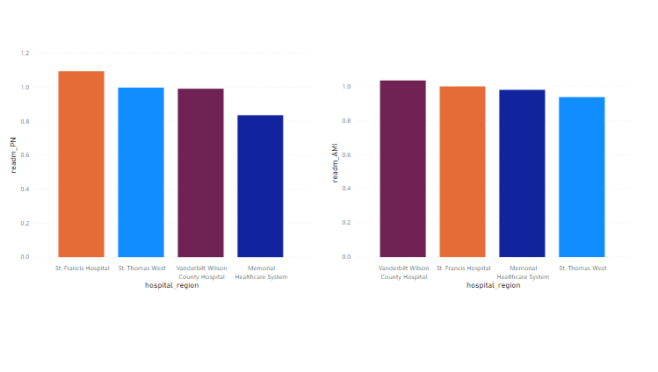
ERR FOR THE 6 DEFINED CONDITIONS PER HOSPITAL
PNEUMONIA
ACUTE MYOCARDIAL INFARCTION

Slide 9
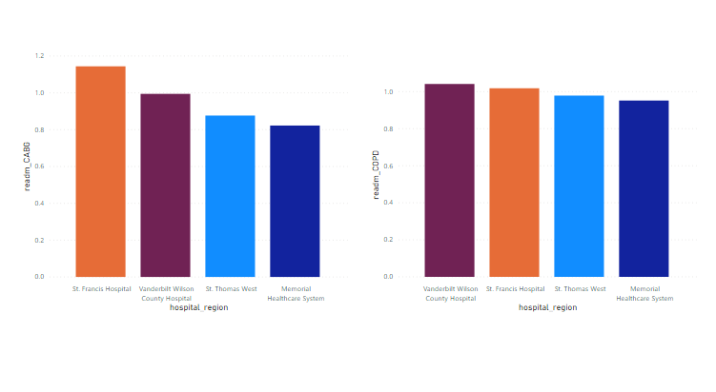
CORONARY ARTERY BYPASS GRAFT
CHRONIC OBSTRUCTIVE PULMONARY DISORDER

Slide 10
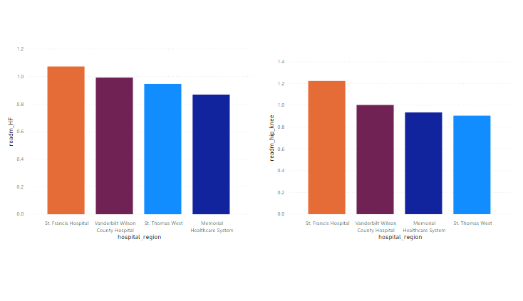
HEART FAILURE
HIP/KNEE REPLACEMENT

Slide 11
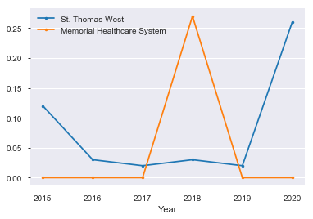
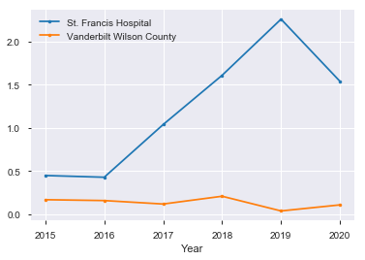
EXCESS READMISSION PENALTY PER PEER GROUP FROM 2015-2019
PEER GROUP 1 PEER GROUP 4

Slide 12
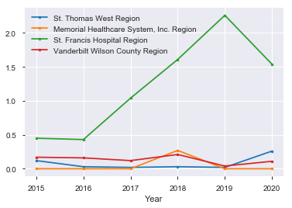
COMPARISON OF HOSPITALS’ PENALTIES FROM BOTH PEER GROUPS

Slide 13
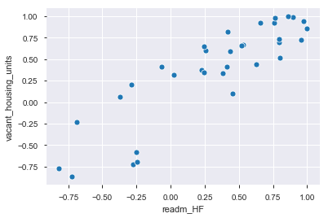
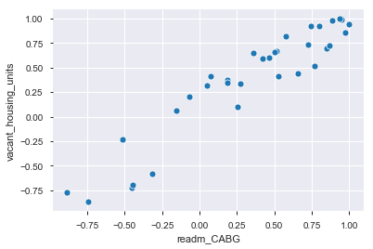
A THUMBNAIL ANALYSIS OF THE RELATIONSHIP BETWEEN SDoH AND THE
6 ERR CONDITIONS
VACANT HOUSING UNITS & ERR FOR HF VACANT HOUSING UNITS & ERR FOR CABG
Notes:
IN THE ABOVE SCATTER PLOTS, WE CAN SEE A POSITIVE CORRELATION BETWEEN THE CONDITIONS HEART FAILURE/CABG AND THE SOCIOECONOMIC CHARACTERISTIC OF
VACANT HOUSING UNITS.

Slide 14
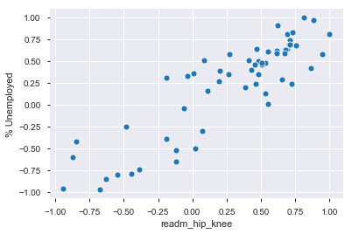
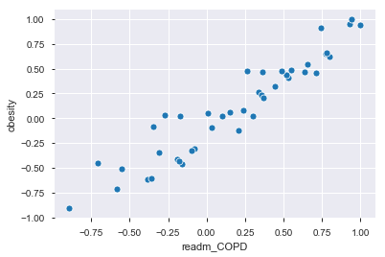
% UNEMPLOYED & ERR FOR HIP/KNEE REPLACEMENT OBESITY & ERR FOR COPD
Notes:
THE LEFT SCATTER PLOT SUGGESTS A CORRELATION BETWEEN THE UNEMPLOYMENT % AND ERR FOR HIP/KNEE REPLACEMENT, WHILE THE RIGHT PLOT SUGGESTS A STRONGER CORRELATION BETWEEN OBESITY AND ERR FOR CHRONIC OBSTRUCTIVE PULMONARY DISEASE.

Slide 15
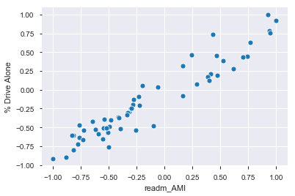
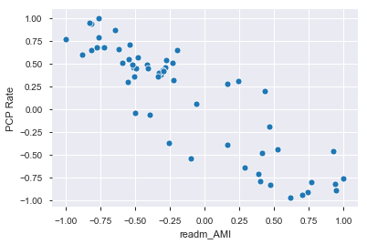
% WHO DRIVE ALONE & ERR FOR AMI PRIMARY CARE PHYSICIAN RATE & ERR FOR AMI
Notes:
HERE, WE SEE A POSITIVE CORRELATION BETWEEN THOSE WHO DRIVE ALONE
AND A HIGH ERR FOR HEART ATTACKS. THE PLOT ON THE RIGHT SUGGESTS A NEGATIVE
CORRELATION, WITH A DECREASE IN THE PRIMARY CARE PHYSICIAN RATE ALONG WITH
THE INCREASE IN THE INCIDENCE OF ERR FOR HEART ATTACKS.

Slide 16
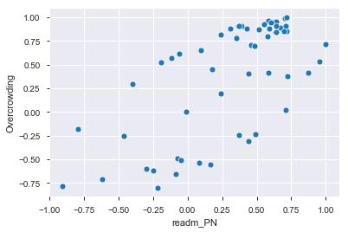
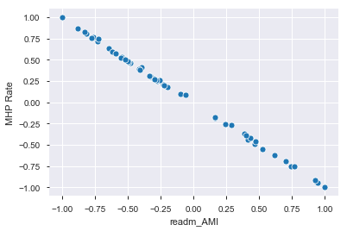
OVERCROWDING & PNEUMONIA MENTAL HEALTH PROVIDER RATE & HEART ATTACK
Notes:
IN THE LEFT SCATTER PLOT, WE SEE A FAIRLY POSITIVE CORRELATION BETWEEN OVERCROWDED HOUSES AND ERR FOR PNEUMONIA. THE PLOT ON THE RIGHT CLEARLY SUGGESTS THAT, AS THE RATE FOR MENTAL HEALTH PROVIDERS DECREASES, THE ERR FOR HEART ATTACKS INCREASES.

Slide 17
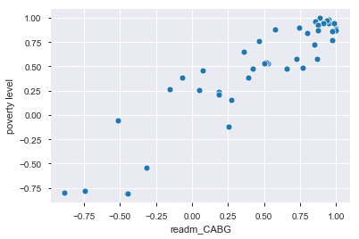
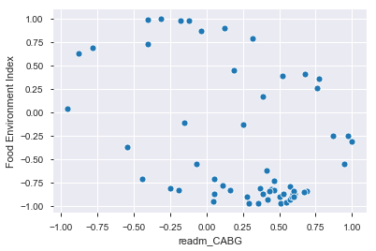
POVERTY LEVEL & ERR FOR CABG FOOD ENVIRONMENT INDEX & ERR FOR CABG
Notes:
THE PLOT ON THE LEFT SHOWS A STRONG CORRELATION BETWEEN POVERTY LEVEL AND ERR FOR CABG, WHILE THE PLOT ON THE RIGHT SHOWS A SLIGHT NEGATIVE CORRELATION BETWEEN THE FOOD ENVIRONMENT INDEX (THE HIGHER THE INDEX, THE MORE ACCESS TO HEALTHY FOODS) AND ERR FOR CABG. THAT IS TO SAY, AS THE INDEX GOES DOWN, THERE IS AN INCREASE IN ERR FOR CABG.

Slide 18
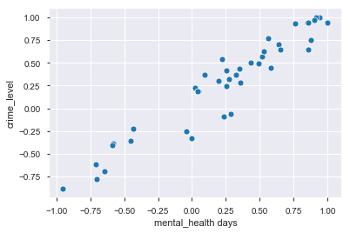
A THUMBNAIL ANALYSIS OF THE CORRELATION AMONG SELECT SOCIAL DETERMINANTS OF HEALTH
CRIME LEVEL & BAD MENTAL HEALTH DAYS
Notes:
THIS PLOT BEARS OUT WHAT MANY STUDIES HAVE SHOWN: THAT A HIGH CRIME RATE CAN
HAVE AN ADVERSE AFFECT ON A PERSON’S MENTAL HEALTH DAYS. IN OTHER WORDS, STRESS
AND OTHER MENTAL HEALTH ISSUES MAY CONCIDE WITH LIVING IN A HIGH CRIME AREA.

Slide 19
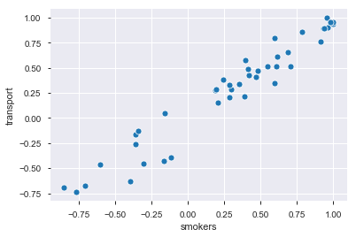
BUS, CYCLE, WALKING TRANSPORT & SMOKERS
Notes:
THIS PLOT SUGGESTS A STRONG CORRELATION BETWEEN A PERSON’S LACK OF A MOTORIZED FORM OF TRANSPORTATION AND SMOKING.

Slide 20
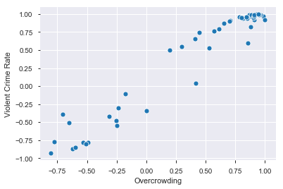
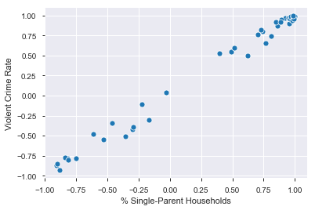
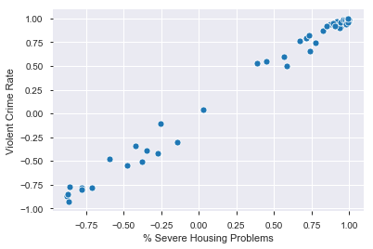
VIOLENT CRIME & OVERCROWDING VIOLENT CRIME & SINGLE-PARENT HOUSEHOLDS
VIOLENT CRIME & SEVERE HOUSING PROBLEMS
Notes:
ALL OF THESE PLOTS FIND A STRONG CORRELATION BETWEEN VIOLENT CRIME AND OVERCROWDED HOUSEHOLDS, SINGLE-PARENT HOUSEHOLDS, AND THOSE WITH SEVERE HOUSING PROBLEMS, RESPECTIVELY.

Slide 21
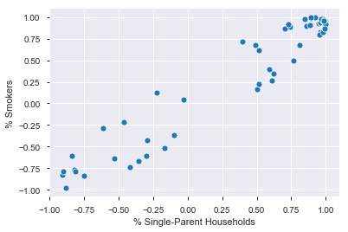
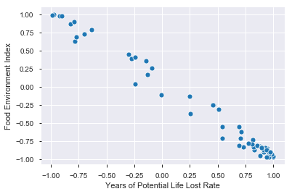
SMOKING & SINGLE-PARENT HOUSEHOLDS
FOOD ENVIRON INDEX & YEARS OF POTENTIAL LIFE LOST
Notes:
THE SCATTER PLOT ON THE LEFT SHOWS A SIGNIFICANT CORRELATION BETWEEN SINGLE-PARENT HOUSEHOLDS AND THE % OF SMOKERS. THE PLOT ON THE RIGHT SHOWS THAT, AS THE FOOD ENVIRONMENT INDEX DECREASES, THE YEARS OF POTENTIAL LIFE LOST RATE INCREASES.

Slide 22
Conclusion:
-MY ANALYSIS SEEMS TO SUPPORT A CORRELATION BETWEEN THE SDoH AND ERR
FOR THE 6 CONDITIONS AT 4 TN HOSPITALS AND, MOREOVER, A CORRELATION AMONG THE
DETERMINANTS THEMSELVES.
-HOW THESE RELATIONSHIPS WORK IS BOTH SIMPLE AND COMPLEX. SIMPLE IN
THE SENSE THAT IT’S NOT HARD TO IMAGINE A PERSON’S SOCIOECONOMIC
CONTEXT AFFECTING HIS/HER HEALTH TRAJECTORY. THE COMPLEXITY LIES IN
HOW ALL THESE FACTORS INTERRELATE, AS IS EVIDENCED BY THE DATA PRESENTED
HERE.
-WITH THIS, RECENT TRENDS IN HEALTH CARE SHOW THAT PROVIDERS ARE INCREASINGLY CONSIDERING THE SDoH IN A PATIENT’S OVERALL HEALTH PICTURE. IN ADDITION, EFFORTS ON THE PART OF GOVERNMENT, COMMUNITY, RELIGIOUS AND PRIVATE ENTITIES HAVE MADE HUGE STRIDES TOWARDS ADDRESSING HEAD-ON THE ISSUES AT THE CORE OF THE SDoH.

Slide 23
DEFINITION OF TERMS
SOCIAL DETERMINANTS OF HEALTH (SDoH):
According to Healthy People.gov, the SDoH include, but are not limited, to the following:
Economic Stability
Education
Social and Community Context
Health and Health Care
Neighborhood and Built Environment
In short, SDoH are “conditions in the environments in which people are born, live, learn, work, play, worship, and age that affect a wide range of health, functioning, and quality-of-life outcomes and risks.”

Slide 24
HOSPITAL READMISSION:
Centers for Medicare & Medicaid Services (CMS) defines a hospital readmission as "an admission to an acute care hospital within 30 days of discharge from the same or another acute care hospital. ... The patient has enrollment information in Medicare for at least 30 days after discharge (this is necessary so that readmissions within 30 days can be tracked).”
HOSPITAL READMISSIONS REDUCTION PROGRAM (HRRP):
Under the Affordable Care Act, CMS began “reducing Medicare payments for Inpatient Prospective Payment System (IPPS) hospitals with excess readmissions. Excess readmissions are measured by a ratio, calculated by dividing a hospital’s

Slide 25
number of “predicted” 30-day readmissions for heart attack (AMI), heart failure (HF), pneumonia, chronic obstructive pulmonary disease (COPD), hip/knee replacement (THA/TKA), and coronary artery bypass graft surgery (CABG) by the number that would be “expected,” based on an average hospital with similar patients.”
EXCESSIVE READMISSION RATIO (ERR):
“Predicted” Readmissions/”Expected” Readmissions = ERR
PEER GROUP MEDIAN ERR:
“The median ERR for the hospital’s peer group for the measure. This is used as the threshold to assess hospital performance relative to other hospitals within the same peer group. All hospitals in the same peer group will have the same median ERR.”

